Slide 1
Lecture 3: Data Driven Visualizations
Credit: Aditya Parameswaran

Slide 2
Groups and QCRs
Complete groups now
Discussion leaders vs research group
QCs are due: Sunday 11:59 pm and Tuesday 11:59 pm
This is to allow discussion leaders to prepare responses
Please start forming research groups
Up to three (this means you can even be on your own)

Slide 3
Today’s Lecture
Why data visualization?
Visualization recommendations
DB-inspired Optimizations

Slide 4
1. Why data visualization?
Section 1

Slide 5
It all started with John Snow
Section 1
Hypothesis at the time:
Diseases such as cholera and bubonic plague are caused by pollution or a noxious form of "bad air”.
John Snow’s Research:
The source of the outbreak was the public water pump
[On the Mode of Communication of Cholera]
Notes:
English physician and a leader in the adoption of anaesthesia and medical hygiene

Slide 6
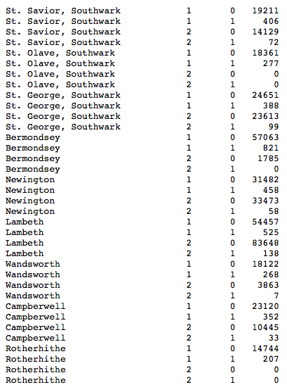
How did he do it?
Section 1
Death/Survival in cholera in 19th century London by district and water company.
Notes:
English physician and a leader in the adoption of anaesthesia and medical hygiene

Slide 7
How did he do it?
Section 1
Snow's data visualization study is regarded as the founding event of the science of epidemiology.
Notes:
English physician and a leader in the adoption of anaesthesia and medical hygiene

Slide 8
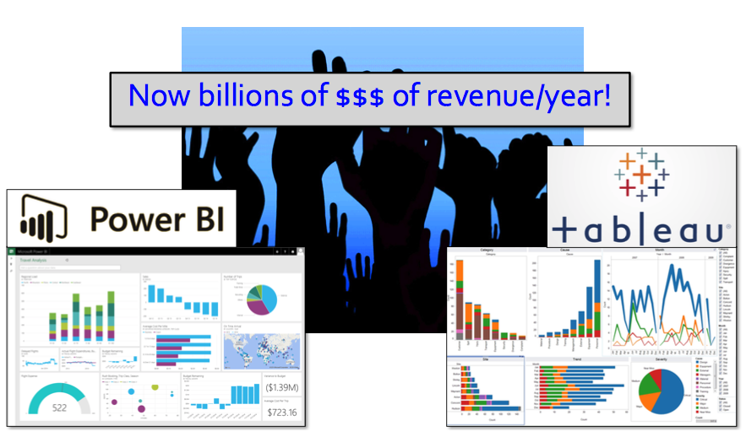
Data Visualizations Today
Section 1

Slide 9
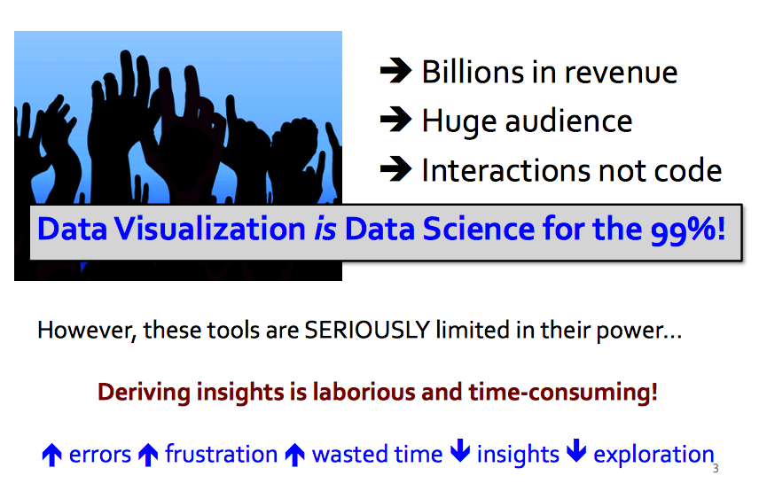
Data Visualizations Today
Section 1

Slide 10
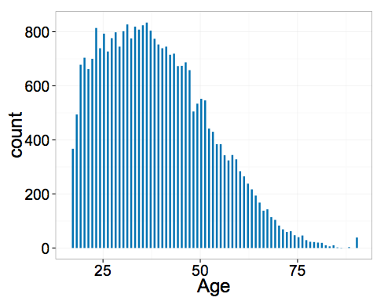
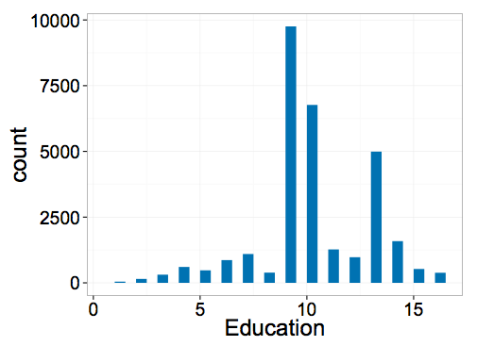
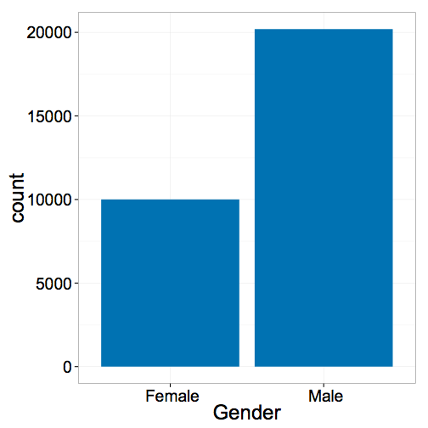
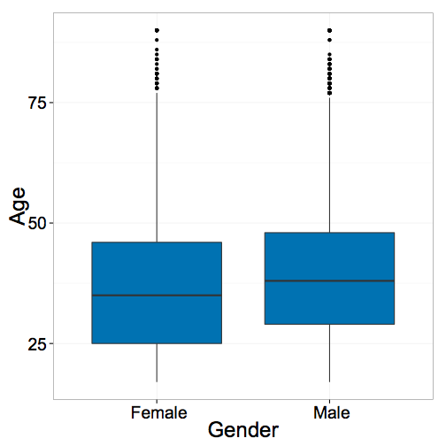
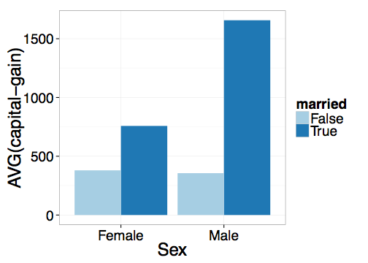
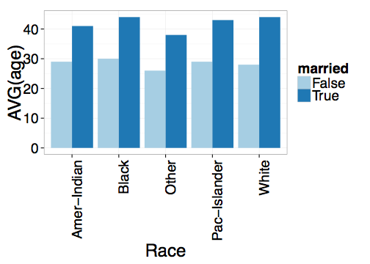
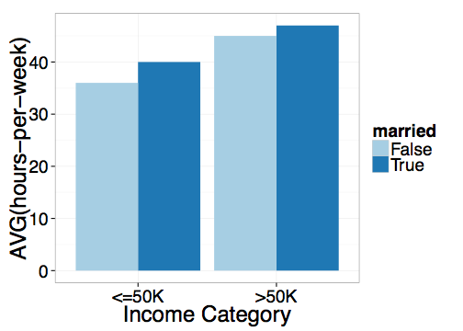
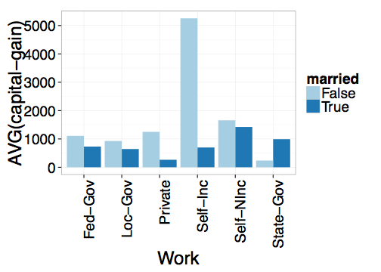
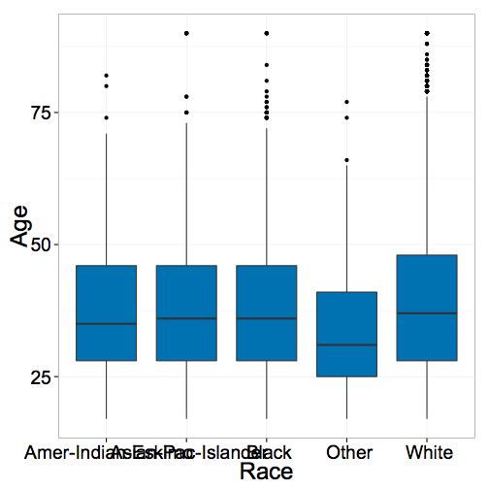
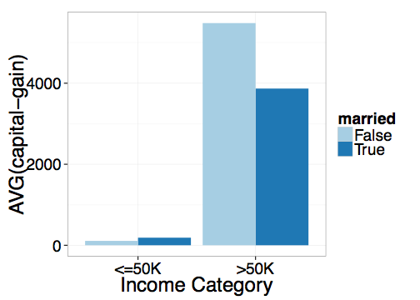
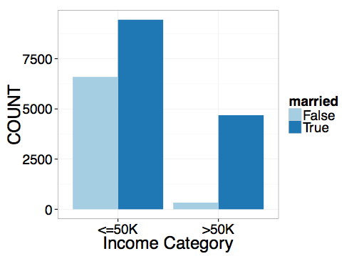
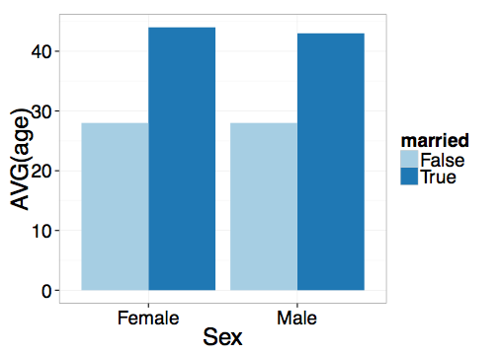
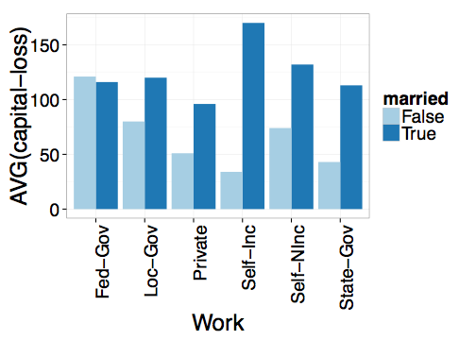
Section 1
Standard Data Visualization Recipe:
Load dataset into data viz tool
Start with a desired hypothesis/pattern (explore combination of attributes)
Select viz to be generated
See if it matches desired pattern
Repeat 3-4 until you find a match

Slide 11
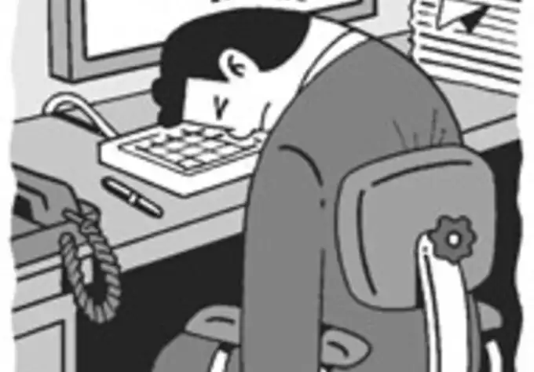
Section 1
Tedious and Time-consuming!
Key Issue:
Visualization can be generated by:
varying subsets of data
varying attributes being visualized
Too many visualization to look at to find desired visual patterns!

Slide 12
2. Visualization recommendations
Section 2

Slide 13
What you will learn about in this section
Section 1
Space of Visualizations
Recommendation Metrics

Slide 14
Goal
Section 1
Given a dataset and a task, automatically produce a set of visualizations that are the most “interesting” given the task
Particularly vague

Slide 15
Goal
Section 1
Given a dataset and a task, automatically produce a set of visualizations that are the most “interesting” given the task

Slide 16
Example
Section 2
Data analyst studying census data
age, education, marital-status, sex, race, income, hours-worked etc.
A = # attributes in table
Task: Compare on various socioeconomic indicators, unmarried adults vs. all adults

Slide 17
Space of visualizations
Section 2
For simplicity, assume a single table (star schema)
Visualizations = agg. + grp. by queries
Vi = SELECT d, f(m)
FROM table
WHERE ___
GROUP BY d
(d, m, f):
dimension, measure, aggregate

Slide 18
Space of visualizations
Section 2
Vi = SELECT d, f(m)
FROM table
WHERE ___
GROUP BY d
(d, m, f):
dimension, measure, aggregate
{d} : race, work-type, sex etc.
{m} : capital-gain, capital-loss, hours-per-week
{f} : COUNT, SUM, AVG

Slide 19
Goal
Section 1
Given a dataset and a task, automatically produce a set of visualizations that are the most “interesting” given the task

Slide 20
Interesting visualizations
Section 2
A visualization is interesting if it displays
a large deviation from some reference
Task: compare unmarried adults with all adults
Deviation-based Utility
Target
Reference
V1 = SELECT d, f(m) FROM table WHERE target GROUP BY d
V2 = SELECT d, f(m) FROM table WHERE reference GROUP BY d
V₁
V₁
Compare induced probability distributions!
V₂
V₂

Slide 21
Deviation-based Utility Metric
Section 2
A visualization is interesting if it displays
a large deviation from some reference
Many metrics for computing distance between distributions
D [P( V1), P(V2)]
Earth mover’s distance
L1, L2 distance
K-L divergence
Any distance metric b/n distributions is OK!
V₁
V₂

Slide 22
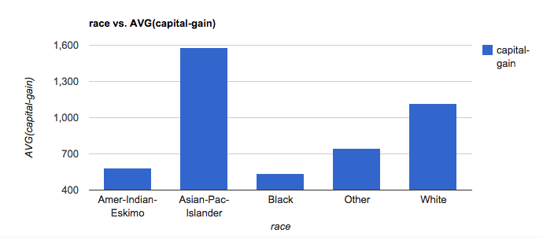
Computing Expected Trend
Section 2
Race vs. AVG(capital-gain)
_{Reference Trend}
SELECT race, AVG(capital-gain) FROM census GROUP BY race
P(V₁)
Expected
Distribution

Slide 23
Computing Actual Trend
Section 2
Race vs. AVG(capital-gain)
_{TargetTrend}
SELECT race, AVG(capital-gain) FROM census GROUP BY race WHERE marital-status=‘unmarried’
P(V₂)
Actual Distribution

Slide 24
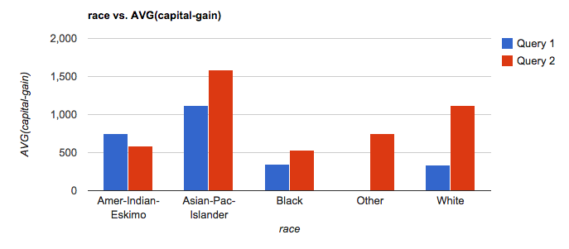
Computing Utility
Section 2
U = D[P(V₁) , P(V₂)]
D = EMD, L2 etc.

Slide 25

Low Utility Visualization
Section 2
Actual
Expected

Slide 26
High Utility Visualization
Section 2
Actual
Expected

Slide 27
Other metrics
Section 2
Data characteristics
Task or Insight
Semantics and Domain Knowledge
Visual Ease of Understanding
User Preference

Slide 28
3. DB-inspired Optimizations
Section 3

Slide 29
What you will learn about in this section
Section 3
Ranking Visualizations
Optimizations

Slide 30
Ranking
Section 3
Across all (d, m, f), where
V1 = SELECT d, f(m) FROM table WHERE target GROUP BY d
V2 = SELECT d, f(m) FROM table WHERE reference GROUP BY d
Vi = (d: dimension, m: measure, f: aggregate)
10s of dimensions, 10s of measures, handful of aggregates
2* d * m * f
100s of queries for a single user task!
Can be even larger. How?
Goal: return k best utility visualizations (d, m, f),
(those with largest D[V1, V2])

Slide 31
Even larger space of queries
Section 3
Binning
3 dimensional or 4 dimensional visualizations
Scatterplot or map visualizations
…

Slide 32
Back to ranking
Section 3
Across all (d, m, f), where
V1 = SELECT d, f(m) FROM table WHERE target GROUP BY d
V2 = SELECT d, f(m) FROM table WHERE reference GROUP BY d
Goal: return k best utility visualizations (d, m, f),
(those with largest D[V1, V2])
Naïve Approach
For each (d, m, f) in sequence
evaluate queries for V1 (target), V2 (reference)
compute D[V1, V2]
Return the k (d, m, f) with largest D values

Slide 33
Issues with Naïve Approach
Section 3
Repeated processing of same data in sequence across queries
Computation wasted on low-utility visualizations
Sharing
Pruning

Slide 34
Optimizations
Section 3
Each visualization = 2 SQL queries
Latency > 100s
Minimize number of queries and scans

Slide 35
Optimizations
Section 3
Combine aggregate queries on target and ref
Combine multiple aggregates
(d1, m1, f1), (d1, m2, f1) → (d1, [m1, m2], f1)
Combine multiple group-bys*
(d1, m1, f1), (d2, m1, f1) → ([d1, d2], m1, f1)
Could be problematic…
Parallel Query Execution

Slide 36
Combining Multiple Group-by’s
Section 3
Too few group-bys leads to many table scans
Too many group-bys hurt performance
# groups = Π (# distinct values per attributes)
Optimal group-by combination ≈ bin-packing
Bin volume = log S (max number of groups)
Volume of items (attributes) = log (|a_{i}|)
Minimize # bins s.t.
Σ_{i} log (|a_{i}|) <= log S

Slide 37
Pruning optimizations
Section 3
Discard low-utility views early to avoid wasted computation
Keep running estimates of utility
Prune visualizations based on estimates
Two flavors
Vanilla Confidence Interval based Pruning
Multi-armed Bandit Pruning

Slide 38
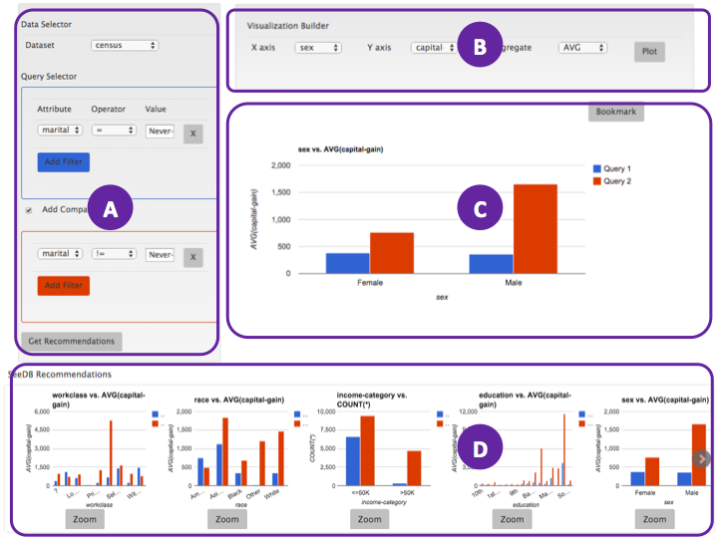
Visualizations
Middleware
Layer
Queries (100s)
Optimizer
DBMS
Sharing
Pruning

Slide 39
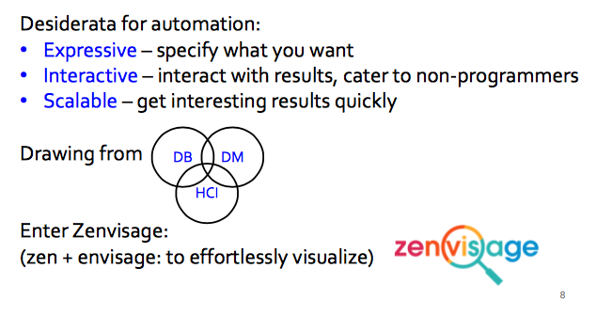
More on automated visualizations
Section 3

Slide 40
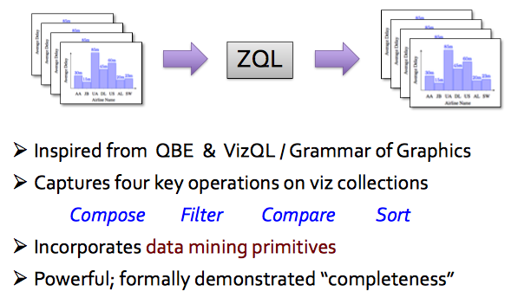
ZQL: a viz exploration language
Section 3

Slide 41
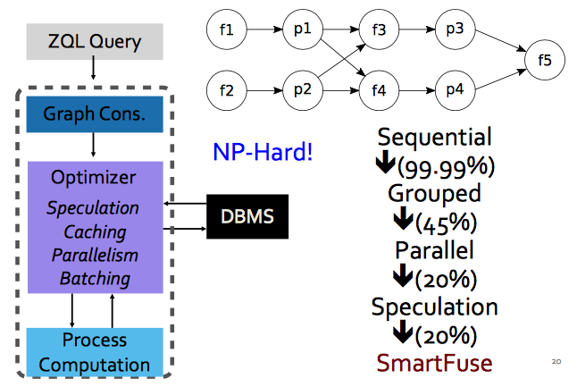
Intelligent query optimizer
Section 3

Slide 42
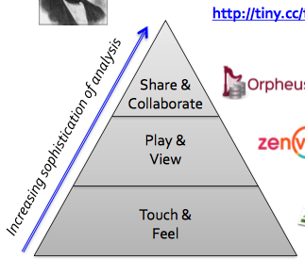
Summary
Summary
Human in the loop analytics are here to stay!

